Slide 1
CS152 Section 9
Vectors and GPUs

Slide 2
Agenda
Reminder: PS4/Lab3 Due Monday April 5th
Vector/GPU/SIMT architectures and programming
Lab 4 Overview

Slide 3
Vectorization
Vector stripmining: break loops into pieces that fit in vector registers
Vector masks: help vectorize code with conditional execution
Vector reductions: help vectorize loop-carried dependence
Vector strided loads/stores: Vectorize loop when data is not stored contiguously
Vector scatter/gather: vectorize loop with indirect memory accesses; need to consider loop-carried dependence as well

Slide 4
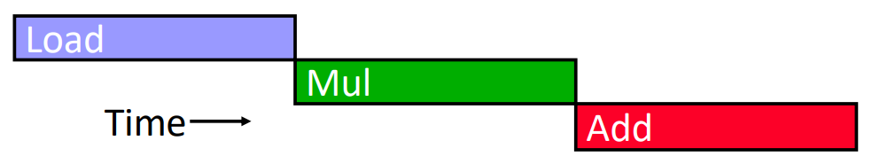
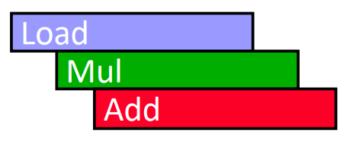
Vector Architecture
Vector chaining: Start dependent instruction as soon as first result appears
With chaining

Slide 5
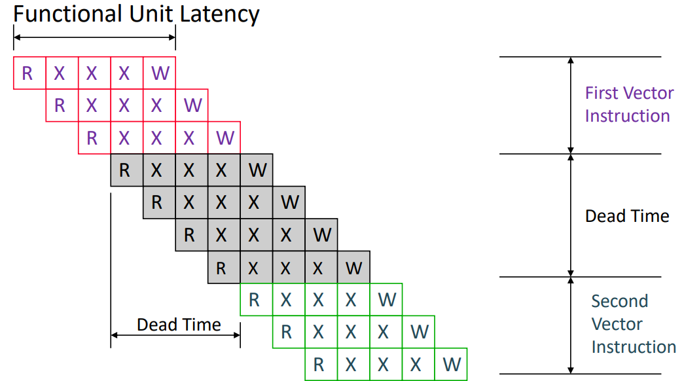
Vector Architecture
Dead time: Time before another vector instruction can start down a pipeline

Slide 6
Q1: Vector Lane Trade-off
Consider the following vector instruction sequence:
vadd v1, v2, v3 vadd v4, v5, v6
The next instruction after that uses a different functional unit. Suppose that VL=32. On which machine would this code perform better:
8 lanes and 2 cycles of dead time
16 lanes and 8 cycles of dead time
Assume a single-cycle ALU

Slide 7
Packed SIMD vs Vectors
Packed/Subword SIMD
Fixed SIMD width encoded in ISA
Separate instruction variant for each width
Not backwards compatible
Shorter vectors
Spatial execution
All elements execute in same cycle
Need ILP to saturate datapath
Utilization suffers as datapath grows wider
Simpler to implement as an extension to an existing scalar microarchitecture
Reuse GPRs, superscalar issue logic
Traditionally lacked predication, indexed memory operations
Vectors
Variable vector lengths
More portable code that can scale to use maximum vector length of the machine
More efficient use of opcode space
Longer vectors
Temporal execution
Vector length greater than number of lanes
Vectors execute over multiple cycles
Better efficiency with fewer instructions
More expressive ISA

Slide 8
GPU vs Vectors
GPUs
SIMT: Individual scalar instruction streams for each microthread are grouped together for SIMD execution on hardware
All memory operations are scatter/gather; rely on coalescing to dynamically detect unit-stride access patterns
Scalar values replicated across threads
Hardware-managed divergence stack
Vector architectures
Highly structured memory access patterns (unit-stride, constant-stride) expressed explicitly
Scalar support, scalar-vector operations
Software predication
Recent GPU architectures incorporate features from vector machines: explicit vector memory operations, shared scalar register file, scalar execution units

Slide 9
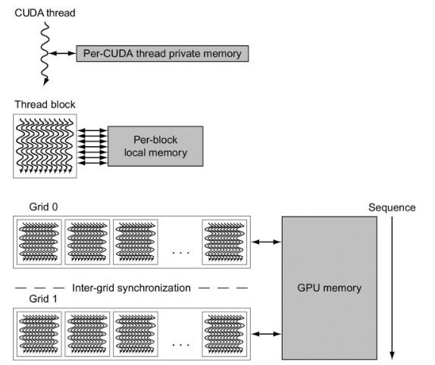
GPU vs Vectors: Memory
What are the ways for vector architectures and GPUs to tolerate memory latency?
Vectors: Long vectors, deeply pipelined memory system; exploit memory-level parallelism and predictability of vector access patterns for prefetching and access/execute decoupling (CS252)
GPUs: Multithreading

Slide 10
Conditional SAXPY: Vectorizable Loop
// y = a*x + y
void csaxpy(size_t n, bool *cond, float a, float *x, float *y) { for (size_t i = 0; i < n; i++) if (cond[i]) y[i] = (a * x[i]) + y[i]; }

Slide 11
Conditional SAXPY: SPMD kernel
csaxpy_spmd<<<((n-1)/32+1)*32>>>; // 1-D thread launch void csaxpy_spmd(size_t n, bool *cond, float a, float *x, float *y) { if (tid.x < n) if (cond[tid.x]) y[tid.x] = (a * x[tid.x]) + y[tid.x]; }

Slide 12
CSAXPY: Vector Assembly
csaxpy_rvv: vsetvli t0, a0, e8, m2, ta, ma # SEW=8 LMUL=2 vle8.v v8, (a1) # load cond[i] vmsne.vi v0, v8, 0 # set mask vsetvli x0, x0, e32, m8, ta, mu # SEW=32 LMUL=8 vle32.v v8, (a2) # load x[i] vle32.v v16, (a3) # load y[i] vfmacc.vf v16, fa0, v8, v0.t # a*x[i] + y[i] vse32.v v16, (a3) # store y[i] sub a0, a0, t0 # decrement AVL add a1, a1, t0 # bump cond slli t0, t0, 2 add a2, a2, t0 # bump x add a3, a3, t0 # bump y bnez a0, csaxpy_rvv ret
for (i = 0; i < n; i++) if (cond[i]) y[i] = (a * x[i]) + y[i];
a0 | size_t n
a1 | bool *cond
fa0 | float a
a2 | float *x
a3 | float *y

Slide 13
CSAXPY: SIMT Assembly
csaxpy_simt: mv t0, tid # get thread ID bgeu t0, a0, skip add t1, a1, t0 # compute cond + i lbu t1, (t1) # load cond[i] beqz t1, skip slli t0, t0, 2 add a2, a2, t0 # compute x + i add a3, a3, t0 # compute y + i flw ft0, (a2) # load x[i] flw ft1, (a3) # load y[i] fmadd.s ft0, fa0, ft0, ft1 # a*x[i] + y[i] fsw ft0, (a3) # store y[i] skip: stop
if (tid < n) if (cond[tid]) y[tid] = (a*x[tid]) + y[tid];
a0 | size_t n
a1 | bool *cond
fa0 | float a
a2 | float *x
a3 | float *y

Slide 14
Q2: Vectorization
Vectorize the following code:
for (i = 0; i < M; i++) {
C[i] = A[2*i+1] + A[2*i] * B[2*i];
}
x1 holds a pointer to array A
x2 holds a pointer to array B
x3 holds a pointer to array C
x4 holds M
Array elements are single-precision values
Assume that the arrays do not overlap in memory. You should not assume that M is an integer multiple of the maximum vector length.

Slide 15
Q2: Vectorization
for (i = 0; i < M; i++) {
v0 = A[2*i+1];
v1 = A[2*i];
v2 = B[2*i];
v0 = v0 + v1 * v2;
C[i] = v0;
}
loop:
vsetvli rd, rs1, SEW, LMUL | vtype <- SEW, LMUL vl <- min(VLMAX, rs1) rd <- vl
vlse32.v vd, (rs1), rs2 | vector strided load rs2 is stride
vfmacc.vv vd, vs1, vs2 | vd[i]=vd[i]+vs1[i]*vs2[i]
vse32.v vs1, (rs1) | vector unit-strided store

Slide 16
Q3: Vectorization
How might the following code be vectorized? Clearly state any assumptions that you used for your answer for what the architecture provides, such as specific instructions, registers, etc.
for (i = 0; i < N; i++) { if (A[i+1]) A[i] = A[i] + B[C[i]]; }
What if the condition were instead A[i-1]?

Slide 17
Lab 4 Overview
Write/optimize RISC-V vector code in assembly and run on ISA simulator
cmplxmult: Complex multiply
dgemv: Double-precision generalized matrix-vector multiply
dgemm: Double-precision generalized matrix-matrix multiply
imax: Index of maximum
spmv: Sparse matrix-vector multiply (open-ended)
rsort: Radix sort (open-ended)

Slide 18
Optional Material

Slide 19
GPU Hardware Divergence Management
If-Then-Else Statement
a = op0 b = op1 p = slt a, b push.stack reconverge # 1 tbranch.eqz p, else # 2 c = op2 # 3 pop.stack # 4 else: c = op3 pop.stack # 5 reconverge: d = op4
Compiler pushes reconvergence point with current thread mask onto the stack
At divergence point, hardware picks one subset (then clause) and pushes the other (else clause) onto the stack
Hardware first executes op2 under updated active mask
Hardware then discards currently executing warp subset and picks next subset at top of the stack (else clause)
Hardware finally pops the PC for the reconvergence point
Yunsup Lee, Decoupled Vector-Fetch Architecture with a Scalarizing Compiler (2016)

Slide 20
GPU Hardware Divergence Management
While Loop
done = false push.stack reconverge # 1 loop: tbranch.neqz done, exit # 2 a = op0 b = op1 done = slt a, b j loop exit: pop.stack # 3 reconverge: c = op2
Compiler pushes reconvergence point with current thread mask onto the stack
Loop executes until all threads have exited
All exiting warp subsets pop a token from the stack, until eventually the reconverged PC with the original mask at the loop entry is recovered
Yunsup Lee, Decoupled Vector-Fetch Architecture with a Scalarizing Compiler (2016)

